Slide 1

Urban Acoustics
Week 7 Tutorial
Cnossos model prof.dr.ir. Maarten Hornikx dr. Matthias Cosnefroy

Slide 2
Cnossos
Problem:
A residential area is located close to a highway. The façade of the closest house is 110 m from the center of the highway. The road has a total vehicle flow of 4000 vehicles per hour which is composed out of 90% lightweight and 10% heavy duty vehicles. The lightweight vehicles have a speed of 120 km/h and the heavy duty vehicles a speed of 80 km/h. For the source, a height of 0 m can be used. The ground between the road and the residential area is of the type compacted lawn and the highway asphalt type ‘very hard and dense’. We consider the highway as a line source and the speed of sound is 340 m/s.
7S0X0
2017/02/09
PAGE <number>

Slide 3
Cnossos
This exercise is the continuation of the exercise of week 6. The noise level per 1/1 octave band L_{p,i} at 110 m from the highway, at a height of 4 m, is shown in the table below for homogeneous conditions (i.e., without wind) with and without the noise barrier.
F (Hz) | L_{p,i} homogeneous, no barrier (dB) | L_{p,i} homogeneous, barrier (dB)
63 | 56.6 | 49.8
125 | 57.2 | 48.1
250 | 56.8 | 45.3
500 | 58.0 | 43.8
1000 | 63.1 | 46.0
2000 | 54.2 | 40.2
4000 | 40.1 | 27.3
7S0X0
2017/02/09
PAGE <number>

Slide 4
Cnossos
a) There is a plan to construct an open car-parking space of 10 m width just in front of the residential area. Before it could be built, the planners want to check if the parking ground will lead to an increase in sound levels at the nearest façade; if it does increase, they plan to build the parking space on the other side. Compute, without the barrier, the difference in A-weighted sound level L_{p,A}.
The terms L_{W,eq,i} , A_{div} and A_{atm,i} are the same as before (without the barrier). A_{ground,i} will change due to the car-parking space though.
Again, 3 steps to compute the ground attenuation:
compute G_{s} and G_{path} based on tabulated values of ground properties
compute G’_{path} with the formula from the lecture
estimate A_{ground,i} from the provided figure, for each octave band
7S0X0
2017/02/09
PAGE <number>

Slide 5
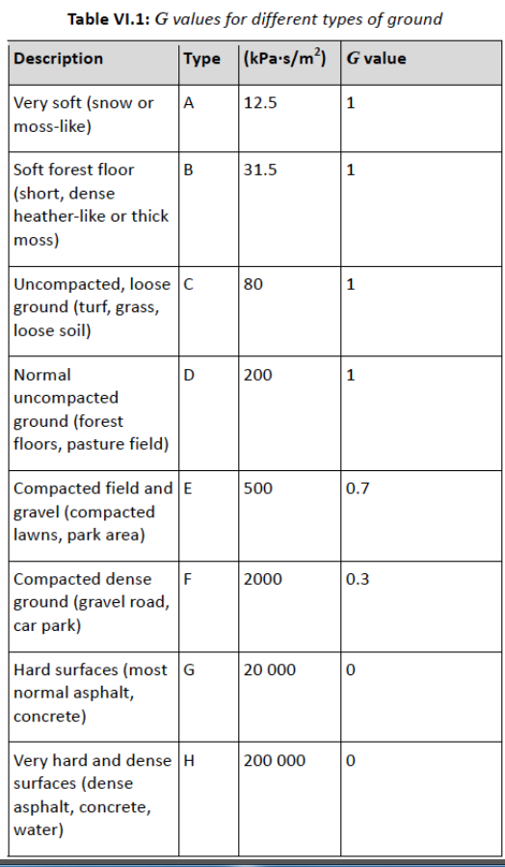
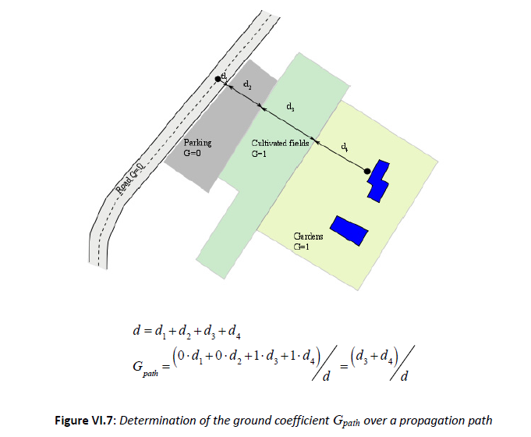
Cnossos
a) There is a plan to construct an open car-parking space of 10 m width just in front of the residential area. Before it could be built, the planners want to check if the parking ground will lead to an increase in sound levels at the nearest façade; if it does increase, they plan to build the parking space on the other side. Compute, without the barrier, the difference in A-weighted sound level L_{p,A}.
As before, ground near the source = dense asphalt, so G_{s} = 0
The ground along the propagation path now consists of 100 m of compacted lawn (G = 0.7) and 10 m of “car park” (G = 0.3)
You thus need to compute G_{path} as the average G over the propagation path, i.e: G_{path}= (0.7 x 100 + 0.3 x 10) / 110 ≈ 0.66
Note: you could have included the road near the source for computing G_{path} , although the difference would have been small since the width of the road is small compared with the total path length (and in any case the influence of the ground near the source is somewhat taken into account via G_{s}).
7S0X0
2017/03/23
2017/02/09
PAGE <number>

Slide 6
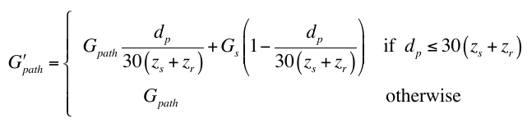
Cnossos
a) There is a plan to construct an open car-parking space of 10 m width just in front of the residential area. Before it could be built, the planners want to check if the parking ground will lead to an increase in sound levels at the nearest façade; if it does increase, they plan to build the parking space on the other side. Compute, without the barrier, the difference in A-weighted sound level L_{p,A}.
Now you can compute G’_{path} with the formula
with d_{p} = 110 m, z_{s} = 0 m and z_{r} = 4 m. We find .
From Figure 1, you can finally (roughly) estimate A_{ground,i}
7S0X0
2017/02/09
PAGE <number>

Slide 7
Cnossos
a) There is a plan to construct an open car-parking space of 10 m width just in front of the residential area. Before it could be built, the planners want to check if the parking ground will lead to an increase in sound levels at the nearest façade; if it does increase, they plan to build the parking space on the other side. Compute, without the barrier, the difference in A-weighted sound level L_{p,A}.
Next, compute the sound level per octave band and apply the A correction
f | L_{W,eq,i} | A_{div} | A_{atm} | A_{ground} | A_{dif} | L_{p,i,old} | L_{p,i,new}
63 | 83.5 | 28.4 | 0.0 | -1.7 | 0.0 | 56.6 | 56,8
125 | 84.2 | 28.4 | 0.0 | -1.7 | 0.0 | 57,2 | 57,4
250 | 83.8 | 28.4 | 0.1 | -1.7 | 0.0 | 56.8 | 57,0
500 | 85.1 | 28.4 | 0.3 | -1.7 | 0.0 | 58.0 | 58,2
1000 | 90.5 | 28.4 | 0.4 | -1.7 | 0.0 | 63.1 | 63,3
2000 | 88.1 | 28.4 | 1.0 | 4.3 | 0.0 | 54.2 | 54,4
4000 | 80.0 | 28.4 | 2.9 | 1.0 | 0.0 | 40.1 | 47.6
L_{p,A,old} = 64.4 dB(A)
L_{p,A,new} = 64.7 dB(A)
Slight amplification, but in principle the car park should go to the other side
(but you could also consider that the difference is smaller than
the uncertainty of the Cnossos model...)
7S0X0
2017/02/09
PAGE <number>

Slide 8
Cnossos
b) For the receiver position at 110 m from the highway and 4 m height, compute the difference in A-weighted sound level L_{p,A} for favourable conditions. Make use of figure 1 for computing the ground effect and make us of A_{div} = 10log₁₀(d)+8, with d the direct distance between source and receiver.
For favorable conditions, the sound level (for one acoustic path) is expressed as
A_{boundary,F,i} is either A_{ground,F,i} or A_{dif,F,i} . Here, there is no barrier so
Note: since the other terms are the same as for homogeneous conditions, you can consider the sound level difference between the homogeneous L_{p,H,i} and the favorable L_{p,F,i} conditions to avoid recomputing all the terms:
7S0X0
2017/02/09
PAGE <number>

Slide 9
Cnossos
b) For the receiver position at 110 m from the highway and 4 m height, compute the difference in A-weighted sound level L_{p,A} for favourable conditions. Make use of figure 1 for computing the ground effect and make us of A_{div} = 10log₁₀(d)+8, with d the direct distance between source and receiver.
Computation of A_{ground,F,i} :
The procedure is exactly the same as for the homogeneous case:
- compute G_{path} and G_{s}
- apply the correction G’_{path} with the same formula
- then use the provided figure to estimate A_{ground,F,i}
(the figure is of course not the same as for the homogeneous case)
7S0X0
2017/02/09
PAGE <number>

Slide 10
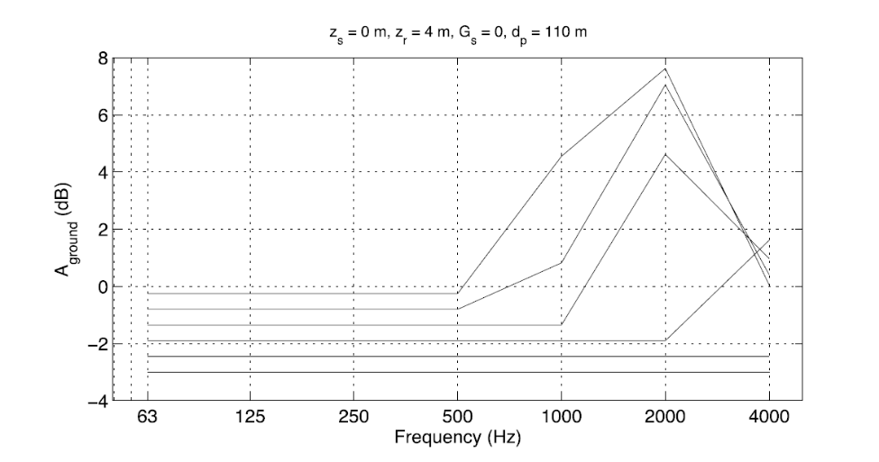
Cnossos
A_{ground} for various values of G’_{path} for favourable conditions. Lines for G’_{path} = 0 (lowermost line) to G’_{path} = 1 (upper line). Other lines with increment of G’_{path} = 0.2.
Here, G’_{path}≈ 0.64 (without the parking from question a)).
You can then estimate A_{ground,F,i} and compute the sound level with favorable conditions.
7S0X0
2017/02/09
PAGE <number>

Slide 11
Cnossos
f (Hz) | L_{p,H,i} (dB) | A_{ground,H,i} (dB) | A_{ground,F,i} (dB) | L_{p,F,i} (dB)
63 | 56.6 | -1,5 | -1 | 56,1
125 | 57,2 | -1,5 | -1 | 56,7
250 | 56,8 | -1,5 | -1 | 56,3
500 | 58,0 | -1,5 | -1 | 57,5
1000 | 63,1 | -1,5 | -1 | 62,6
2000 | 54,2 | 4,5 | 5 | 53,7
4000 | 40,1 | 8,5 | 0.5 | 48,1
A-weighted sound level is now L_{p,F,A} = 64.1 dB(A) (for homogeneous case, it was L_{p,H,A} = 64.4 dB(A))
This is counter intuitive because one would expect an amplification with favorable conditions:
this is because a favorable wind emphasizes the ground effects
7S0X0
2017/02/09
PAGE <number>

Slide 12
Cnossos
c) To reduce the noise level, a thin 4 m tall barrier was proposed at 10 m from the road. For homogeneous conditions, the values of L_{p,H,i} at the receiver point of a) per 1/1 octave band are shown in Table 1. For the same position, compute the difference in A‐weighted sound level L_{p,F,A} for favourable conditions using figure 2.
Answer:
In favorable conditions with a barrier, we can use the formula
As for the previous question, we can also more conveniently compute the difference with the homogeneous case, i.e.,
To compute A_{dif,F,i} use the following formulae
7S0X0
2017/02/09
PAGE <number>

Slide 13
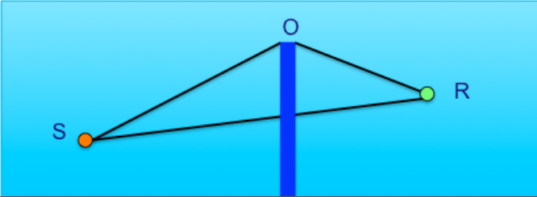
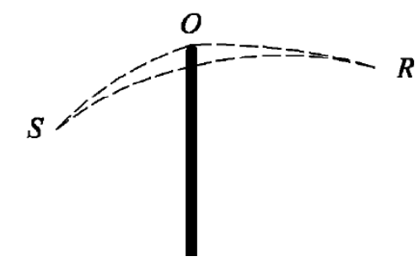
Cnossos
c) To reduce the noise level, a thin 4 m tall barrier was proposed at 10 m from the road. For homogeneous conditions, the values of L_{p,H,i} at the receiver point of a) per 1/1 octave band are shown in Table 1. For the same position, compute the difference in A‐weighted sound level L_{p,F,A} for favourable conditions using figure 2.
With homogeneous conditions: With favorable conditions:
7S0X0
2017/02/09
PAGE <number>

Slide 14
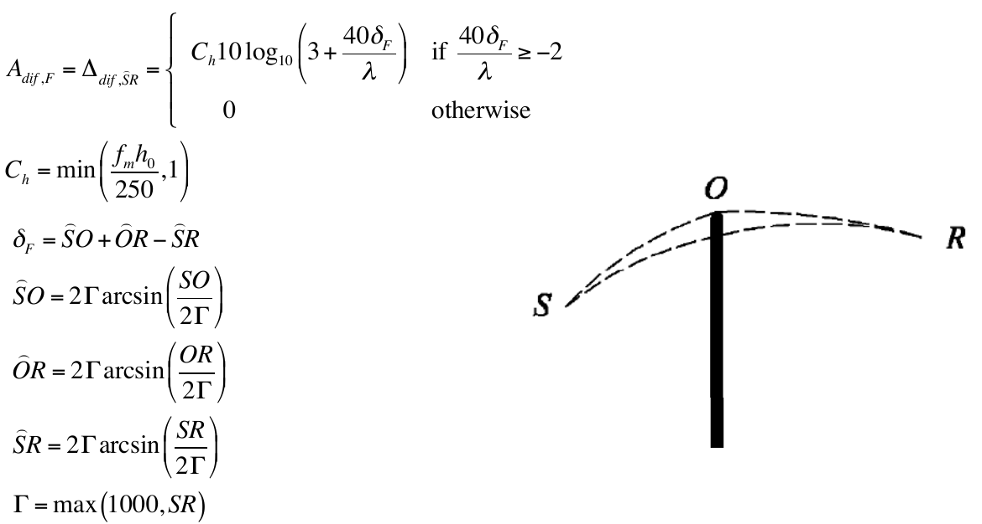
Cnossos
7S0X0
2017/02/09
PAGE <number>

Slide 15
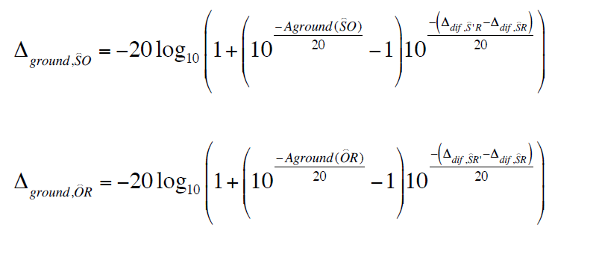
Cnossos
Check out the provided Matlab script for the details of the computations!
7S0X0
2017/02/09
PAGE <number>

Slide 16
Cnossos
f (Hz) | L_{p,H,i} (dB) | A_{dif,H,i} (dB) | A_{dif,F,i} (dB) | L_{p,F,i} (dB)
63 | 49,8 | 5,3 | 5,2 | 49,9
125 | 48,1 | 7,6 | 7,5 | 48,2
250 | 45,3 | 9.9 | 9,8 | 45,5
500 | 43,8 | 12,7 | 12,5 | 43,9
1000 | 46,0 | 15,5 | 15,4 | 46,2
2000 | 40,2 | 18,5 | 18,3 | 40.4
4000 | 27,3 | 21,1 | 21.2 | 27,4
A-weighted sound level is a bit larger and is now L_{p,F,A} = 48.8 dB(A)
for homogeneous case, it was L_{p,H,A} = 48.6 dB(A)
Here, the difference is small because the source is very close to the barrier.
So the barrier is effective even in favorable conditions.
7S0X0
2017/02/09
PAGE <number>

Slide 17
Cnossos
d) A barrier is also located at the other side of the road, see figure 3. Draw the sound rays in figure 3 that determine the sound level at receiver position R due to source position S. Neglect multiple (more than 1) reflections from the noise barrier.
O’
O
Path 1
S
R
O’
O
Path 2
S
R
S’
7S0X0
2017/02/09
PAGE <number>

Slide 18
Cnossos
e) Compute the A-weighted sound level L_{p,A} at the receiver position in the situation of figure 3, that means with the two barriers in homogeneous conditions. Assume the absorption coefficient α_{r,i} from the barrier is equal to 0. Make use of Figure 4.
To compute L_{p,A} , we need to compute the sound levels associated with each path, L_{p,n=1,i} and L_{p,n=2,i} . We already know the level associated with path 1 thanks to the exercises of week 6, so we only need to compute L_{p,n=2,i} , with
Because of the reflection on the second barrier, we consider the image-source S’ as the source for path 2
This means that we “remove” the second barrier, so we just have to consider the diffraction on the first barrier. The problem thus becomes very similar to the exercise of week 6.
7S0X0
2017/02/09
PAGE <number>

Slide 19
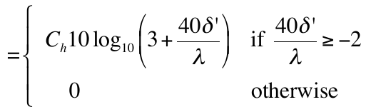

Cnossos
e) Compute the A-weighted sound level L_{p,A} at the receiver position in the situation of figure 3, that means with the two barriers in homogeneous conditions. Assume the absorption coefficient α_{r,i} from the barrier is equal to 0. Make use of Figure 4.
L_{W’,2,i} is the sound power of the virtual source S’, defined as
This corresponds to the sound power of the original source L_{W,2,i} , with a correction factor to account for the absorption of the barrier α_{r,i} , and a correction factor to account for retrodiffraction:
with δ’ = S’O – SO’ – OO’ .
Note: here, there is also a diffraction due to the first barrier, so you must consider the path between the image-source S’ and the diffraction point O, at the top of the first barrier (see previous figure), and not the actual receiver R,
to compute δ’ (see Cnossos report, page 98).
7S0X0
2017/02/09
PAGE <number>

Slide 20
Cnossos
e) Compute the A-weighted sound level L_{p,A} at the receiver position in the situation of figure 3, that means with the two barriers in homogeneous conditions. Assume the absorption coefficient α_{r,i} from the barrier is equal to 0. Make use of Figure 4.
Computing A_{div,2} and A_{atm,2,i} is the same as before, except that you need to consider the path length S’R instead of SR:
A_{div,2} = 10 log₁₀(S’R)+8 (because the road is considered as a line source)
A_{atm,2,i} = α_{i} S’R/1000 dB (the coefficients α_{i} are tabulated, see previous tutorials)
7S0X0
2017/02/09
PAGE <number>

Slide 21
Cnossos
e) Compute the A-weighted sound level L_{p,A} at the receiver position in the situation of figure 3, that means with the two barriers in homogeneous conditions. Assume the absorption coefficient α_{r,i} from the barrier is equal to 0. Make use of Figure 4.
To compute A_{boundary,2,i} , use the same procedure as in tutorial of week 6 with the barrier, except that the source position is now S’:
Again, this formula accounts for the diffraction by the rightmost barrier and for the ground effects on both sides of the barrier.
See the Matlab script for the details of the computations.
7S0X0
2017/02/09
PAGE <number>

Slide 22
Cnossos
e) Compute the A-weighted sound level L_{p,A} at the receiver position in the situation of figure 3, that means with the two barriers in homogeneous conditions. Assume the absorption coefficient α_{r,i} from the barrier is equal to 0. Make use of Figure 4.
To compute A_{boundary,2,i} , use the same procedure as in tutorial of week 6 with the barrier, except that the source position is now S’:
Again, this formula accounts for the diffraction by the rightmost barrier and for the ground effects on both sides of the barrier.
See the Matlab script for the details of the computations.
7S0X0
2017/02/09
PAGE <number>

Slide 23
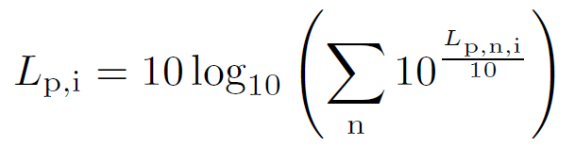
Cnossos
e) Compute the A-weighted sound level L_{p,A} at the receiver position in the situation of figure 3, that means with the two barriers in homogeneous conditions. Assume the absorption coefficient α_{r,i} from the barrier is equal to 0. Make use of Figure 4.
You can now compute L_{p,n=2,i}
The total sound level (per octave band) is then the logarithmic sum of all paths:
And, finally, you need to apply the A correction.
The total sound level is now 54.0 dB(A); with only one barrier, the level was 48.6 dB(A) !
This is because the sound from the road reflects on the second barrier, which creates a new sound path, which is not good for the quietness of the residential area on the right of the road.
7S0X0
2017/02/09
PAGE <number>

Slide 24
Cnossos
f) How much is L_{p,A} reduced when the faces of the barriers have an absorption coefficient α = 0.9 for all frequencies?
With this absorption coefficient, the sound power of the image source is reduced by 10 dB. The sound level associated with path 2 then needs to be recalculated, and the new A-weighted total sound level is found to be 49.6 dB(A), corresponding to a reduction of about 5 dB(A) in the residential area (which is good, although the level is still higher than without the second barrier).
Bottom line: a noise barrier redirects the sound but does not absorb it. It can decrease the noise in an area while increasing the noise somewhere else. Using absorbing materials on or next to the barriers can help with sound absorption.
7S0X0
2017/02/09
PAGE <number>

